Slide 1
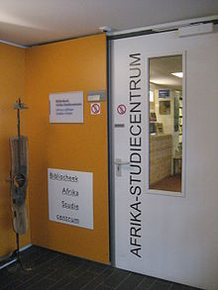
Leiden Alert Service African Studies (LASA)
Ursula Oberst
African Studies Centre (Leiden)
ELIAS 8th Annual Meeting 2014, Frankfurt, 20-6-2014

Slide 2
Content
LASA 1 : library alert service
(abstracting at the ASC; features; ASC subject categories; technical background)
LASA 2 : acquisitions list
(features; technical background)
LASA 3 : semi-automatic import of journal articles (features; technical background)
LASA 4: Connecting-Africa

Slide 3
Abstracting at the African Studies Centre
Abstracting started in the 1950s
Documentatieblad (1968-1993)
African Studies Abstracts (1994-2002)
African Studies Abstracts Online (2003-2014)
Total number of published abstracts: about 80,000 in > 45 years
What’s next ?
Literature: Marlene van Doorn: “A half century of abstracting at the African Studies Centre Leiden”. In: African Research and Documentation: (2013), no. 123 p. 15-23

Slide 4
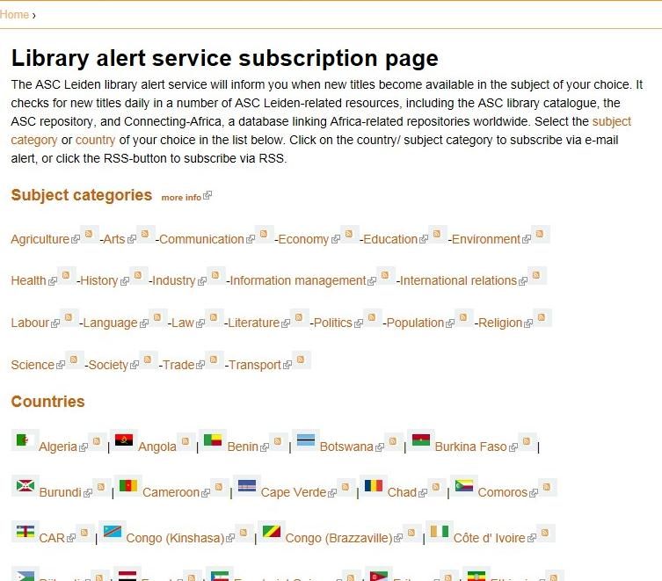
LASA 1 : library alert service
Resources:
ASC library catalogue
ASC collection in Leiden repository
Connecting-Africa
Choice:
Subject categories (from ASC thesaurus)
Countries
Delivery:
RSS
E-mail
http://www.ascleiden.nl/content/library-alert-service-subscription-page

Slide 5
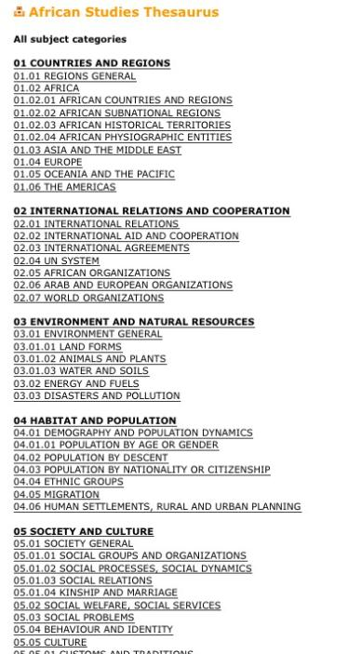
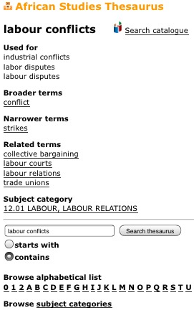
ASC subject categories
http://thesaurus.ascleiden.nl/
OPAC

Slide 6
LASA 1 : library alert service
Technical background:
RSS Feeds
Yahoo Pipes (feed aggregator and manipulator)
Feedburner (feed management tool)
Creator:
Germa Seuren, g.seuren@ascleiden.nl
Tip: Starting point Yahoo Pipes
Bianca Kremer, http://voginmashups.wordpress.com/
Worldcat developer
Germa Seuren
http://www.ascleiden.nl/content/library-alert-service-subscription-page

Slide 7
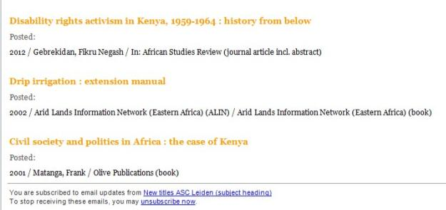
LASA 1 : library alert service
Delivery:
RSS
E-mail
Yahoo Pipe features:
View Source and Clone
Add text
http://www.ascleiden.nl/content/library-alert-service-subscription-page

Slide 8
LASA 1 : library alert service
Latest feature:
Custom alert
Beta version
Corrections and suggestions are very welcome !
Germa Seuren, g.seuren@ascleiden.nl
http://www.ascleiden.nl/content/library-alert-service-subscription-page

Slide 9
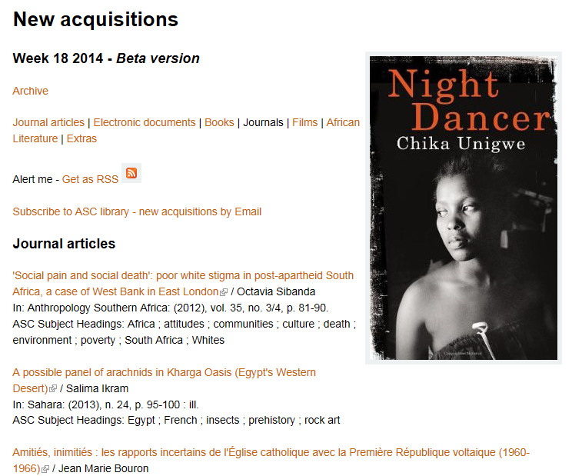
LASA 2 : Acquisitions list
Features:
Weeky, searchable in Google, with extras (abstracts & all titles in RIS)
Technical background:
Export form OCLC database
Conversion via Reference Manager
Copy/Paste Drupal CMS
Beta version
Corrections and suggestions are very welcome !
Ursula Oberst, oberst@ascleiden.nl
Extras:
Read all journal abstracts
All titles in RIS
http://www.ascleiden.nl/content/new-acquisitions

Slide 10
LASA 3 : semi-automatic import of journal articles
Challenge:
How to ensure a constant annual production of abstracts?
Step 1
Make use of existing abstracts (copy/paste) ("Ready-made" abstracts <=>self-made abstracts)
Step 2
Acquire/import metadata records including abstracts (LASA 3)
Source: Marlene van Doorn, ARD, 23 (2013), p. 20

Slide 11
LASA 3 : semi-automatic import of journal articles
Procedure for Taylor & Francis journals:
RSS Check for new issues
Download articles via citation manager T&F
Conversion via in Reference Manager (RM) to script
Run script in OCLC-PICA database
Evaluation & extension (more journals, more publishers, different procedures)
E-only subscriptions

Slide 12
LASA 4 : revitalization of Connecting-Africa
Recent/future activities
Resumption regular updates CA (started december 2013)
Improvements user interface (started)
Improvements post harvest analyzer
Review expert module
http://www.connecting-africa.net/

Slide 13
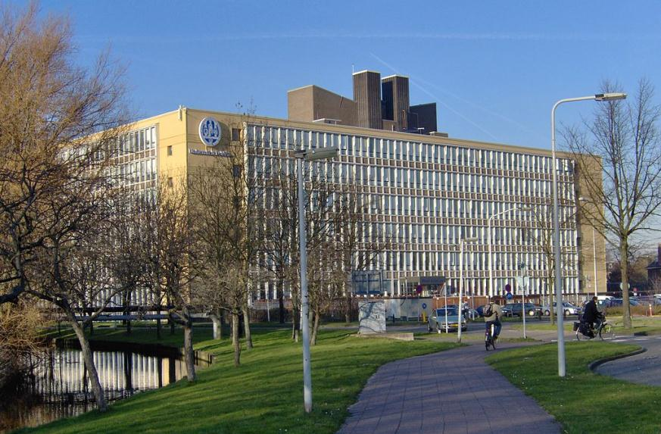
African Studies Centre, Leiden
Name oberst@ascleiden.nl

